Slide 1

Tridel Data Analytics
Problem Definition
Investigate the crucial and influential features which greatly affect the condominium quality.
Find an effective score function that can be used to measure unit quality as a single scalar.
Design pairwise/listwise comparison models which help to predict the quality rank on any arbitrarily selected condominium units.
Use the above models to test our score function.

Slide 2
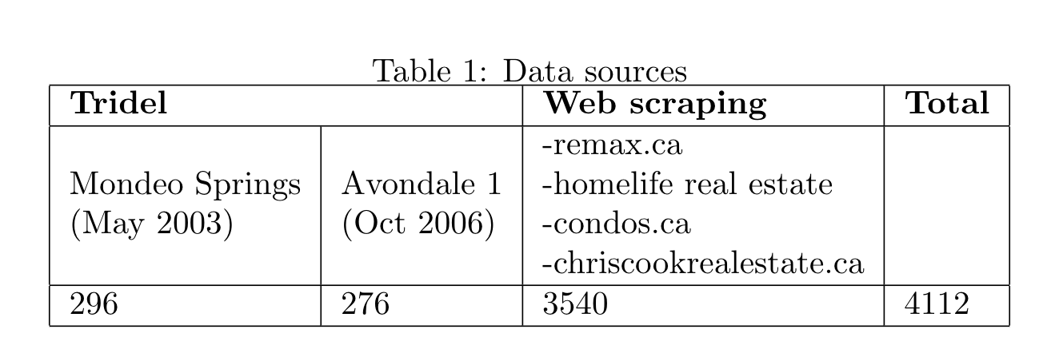
4112 condominium condominium units located in the great Toronto area, from 67/140 different neighbourhoods.
Features:
Housing Characteristics:
Unit size, number of bathrooms, number of bedrooms
Neighbourhood scores:
Crime rate, transit, health, entertainment, community, education, employment, diversity, shopping

Slide 3
Price Predictor
Network Components:
Fully-Connected Layer (FC):
neurons from the previous and current layers are mutually connected
Dropout:
Randomly turn off neurons to prevent over-fitting and enable model ensembles
Network Architecture:
Input -> FC -> Dropout -> FC -> Dropout -> FC -> Dropout -> Output
Critical Factor Analysis :
Influential Features -> more connections & larger weights
-> as score model priors/constraints

Slide 4
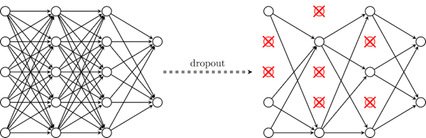
Graphical Representation
Input -> FC -> Dropout -> FC -> Dropout -> FC -> Dropout -> Output
https://cambridgespark.com/content/tutorials/convolutional-neural-networks-with-keras/index.html

Slide 5
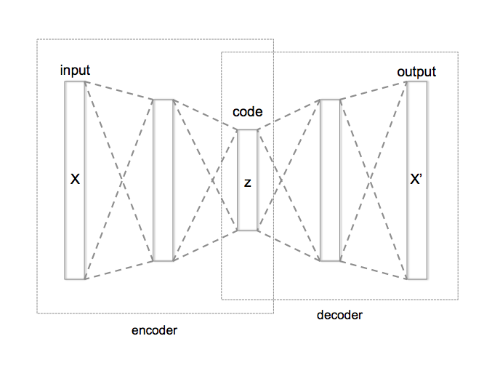
Autoencoder
Mechanism for learning effective inner representations -> lower dimensions
Unsupervised learning -> no need for labels
Easy to extend -> various constraints can be applied
X : Original input
(size, # of rooms,
neighborhood scores)
Z : down-sized representation
(score function)
X’ : up-sized output
(reconstructed input)
https://en.wikipedia.org/wiki/Autoencoder#/media/File:Autoencoder_structure.png

Slide 6
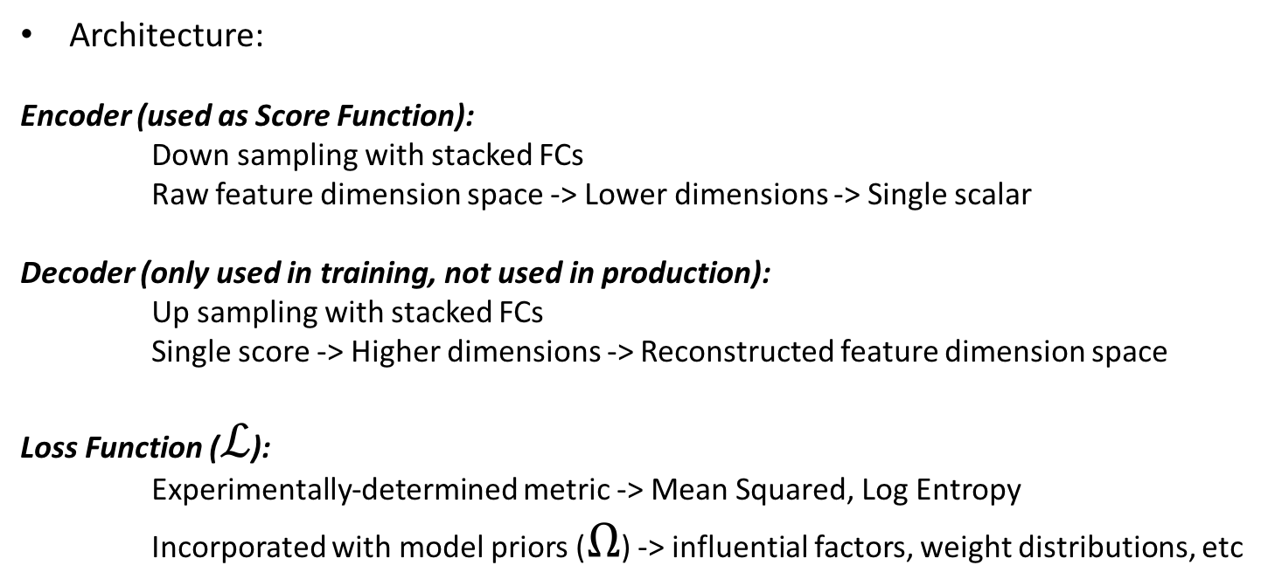
Score Function
Architecture:
Encoder (used as Score Function):
Down sampling with stacked FCs
Raw feature dimension space -> Lower dimensions -> Single scalar
Decoder (only used in training, not used in production):
Up sampling with stacked FCs
Single score -> Higher dimensions -> Reconstructed feature dimension space
Loss Function ($ℒ$):
Experimentally-determined metric -> Mean Squared, Log Entropy
Incorporated with model priors ($Ω$) -> influential factors, weight distributions, etc

Slide 7
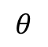
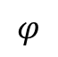
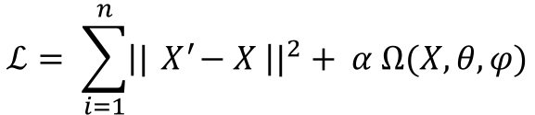
Graphical Representation
$$ℒ= \sum_{i=1}^{n}{{\left||{ X}^{′}−X \right||}^{2}+ α Ω(X,θ, φ)}$$
$$θ$$
$$φ$$
Score Function
Raw Features
Reconstructed
Features

Slide 8
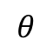
Hierarchical Autodencoder
Number of bedrooms
(raw)
$$θ$$
Number of bathrooms
(raw)
Size of unit
(raw)
Score Function
Neighborhood Score
(composite feature)
Intermediate
layer

Slide 9
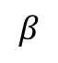
Neighborhood Score
Neighborhood Features
(9 in total)
Entertainment
$$β$$
Transit
Education
…
…
Neighborhood
Score

Slide 10
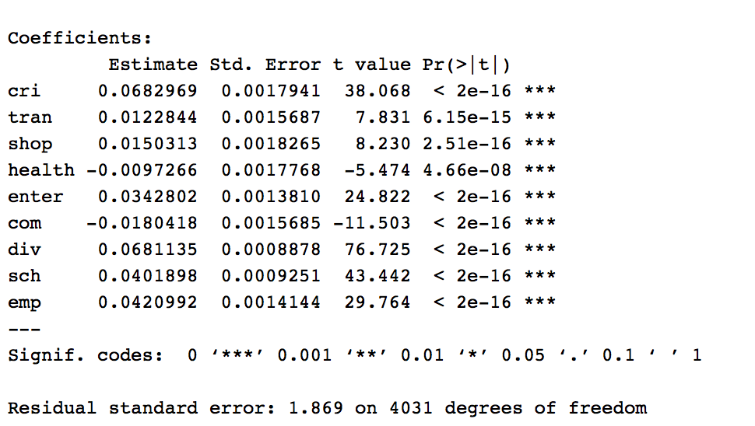
Penalty Assignment
Rule: The greater the importance, the lower the penalty. Reciprocal
If slope is positive, penalty = 1/ estimate
If slope is negative, penalty = 1/(-estimate*0.1)
Regression model: log(price) ~ neighbourhood features

Slide 11
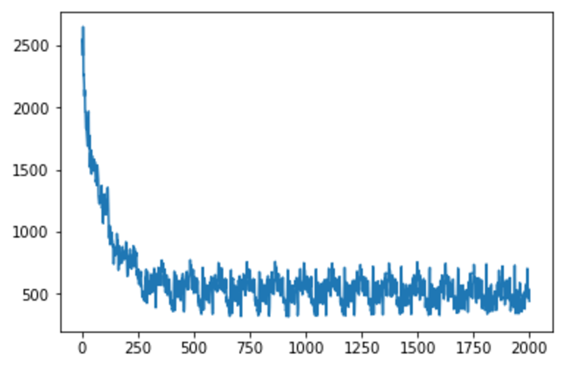
Neighbourhood Encoder
crime_penalty = 14.641953
transit_penalty = 81.404057
shop_penalty = 66.527845
health_penalty = 1028.108486
enter_penalty = 29.171358
com_penalty = 554.268421
div_penalty = 14.681377
sch_penalty = 24.881935
emp_penalty = 23.753420
X: iterations
Y: cost

Slide 12
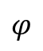
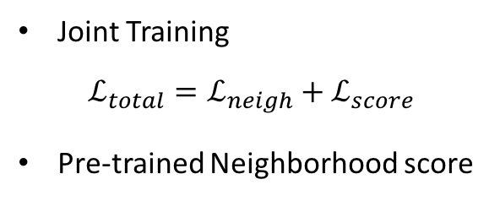
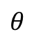
Training
Joint Training
$$ℒ_{total}=ℒ_{neigh}+ℒ_{score}$$
Pre-trained Neighborhood score
…
Neighborhood score
$$θ$$
$$φ$$
Score Function

Slide 13
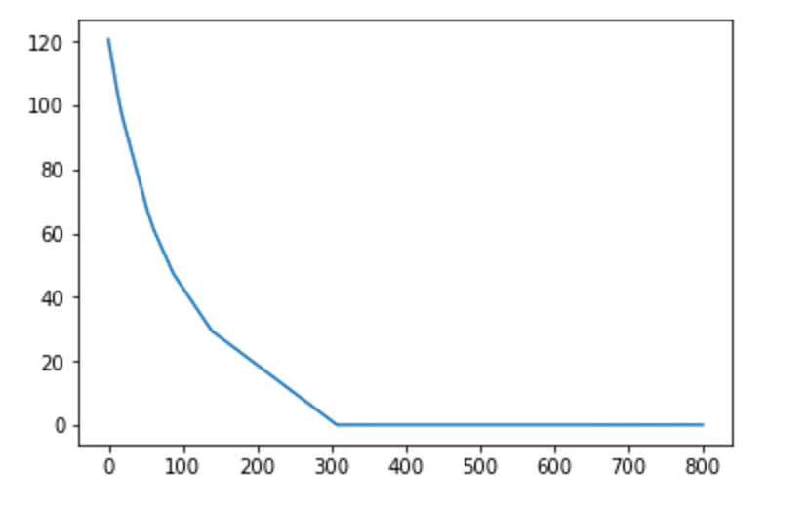
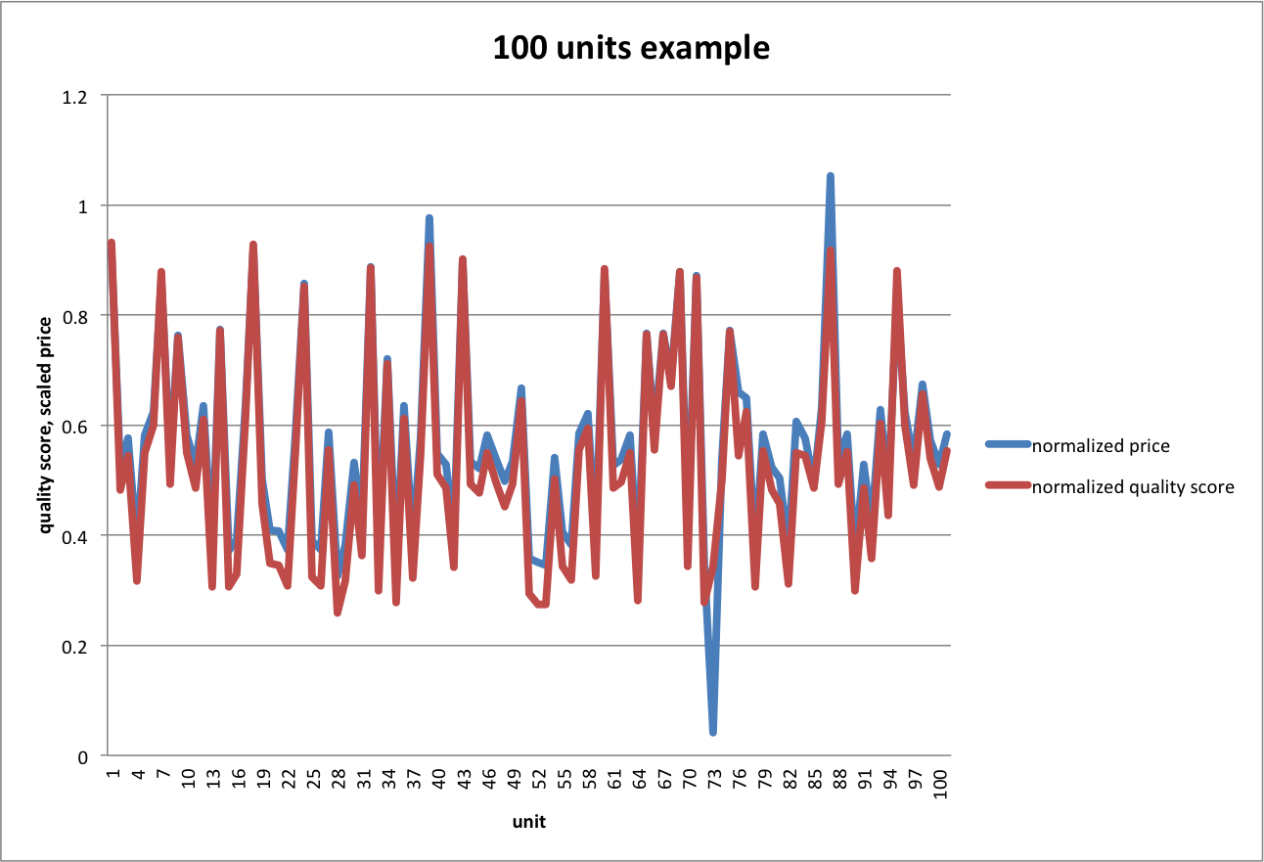
Method 1
Subjectively assign the penalty rates to four features based on the global regression output.
bed_penalty = 0
bath_penalty = 25
size_penalty = 0
neigh_penalty = 5

Slide 14
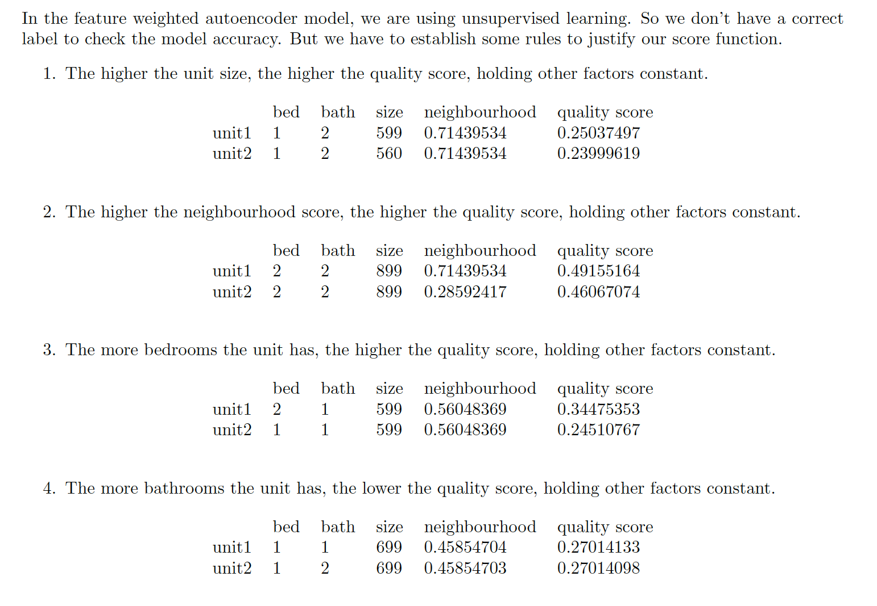
Experiment

Slide 15
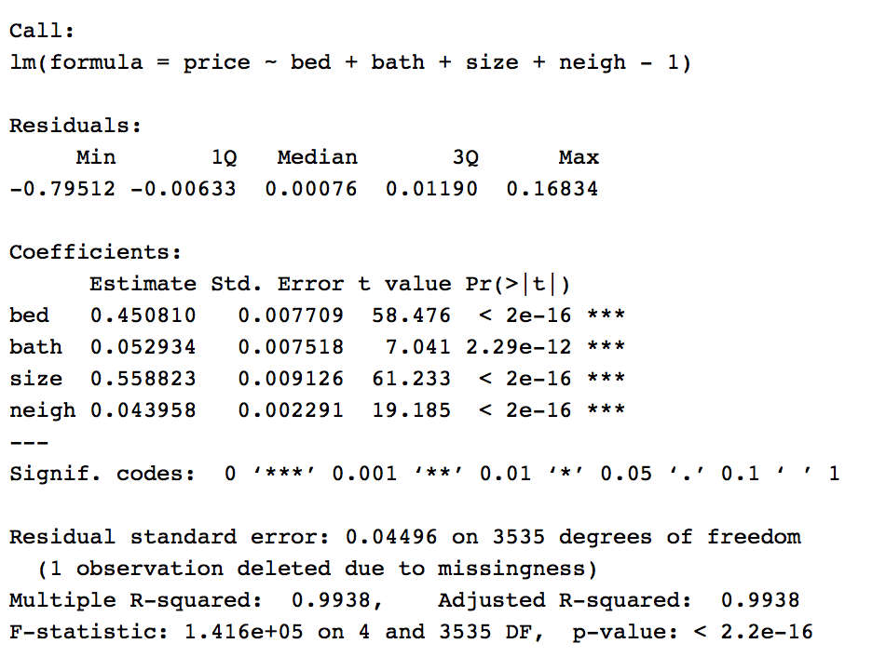
Method2
Regress price on unit size, # of bedrooms, # of bathrooms and encoded neighbourhood score.
Apply the reciprocal method again.
All the feautures are normalized.

Slide 16
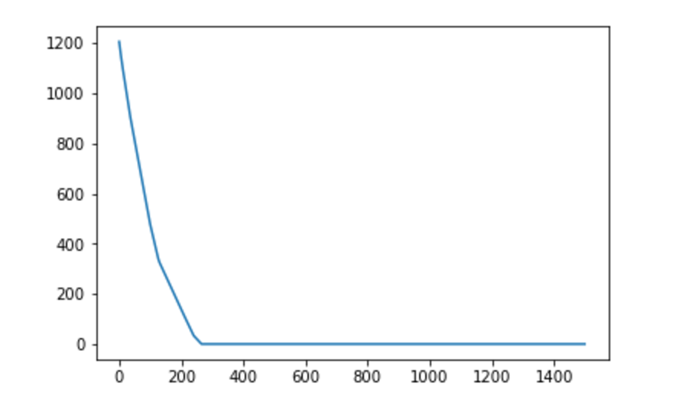
Training
bed_penalty = 2.218229
bath_penalty = 188.914497
size_penalty = 1.789475
neigh_penalty = 22.748988
X: iterations
Y: cost

Slide 17
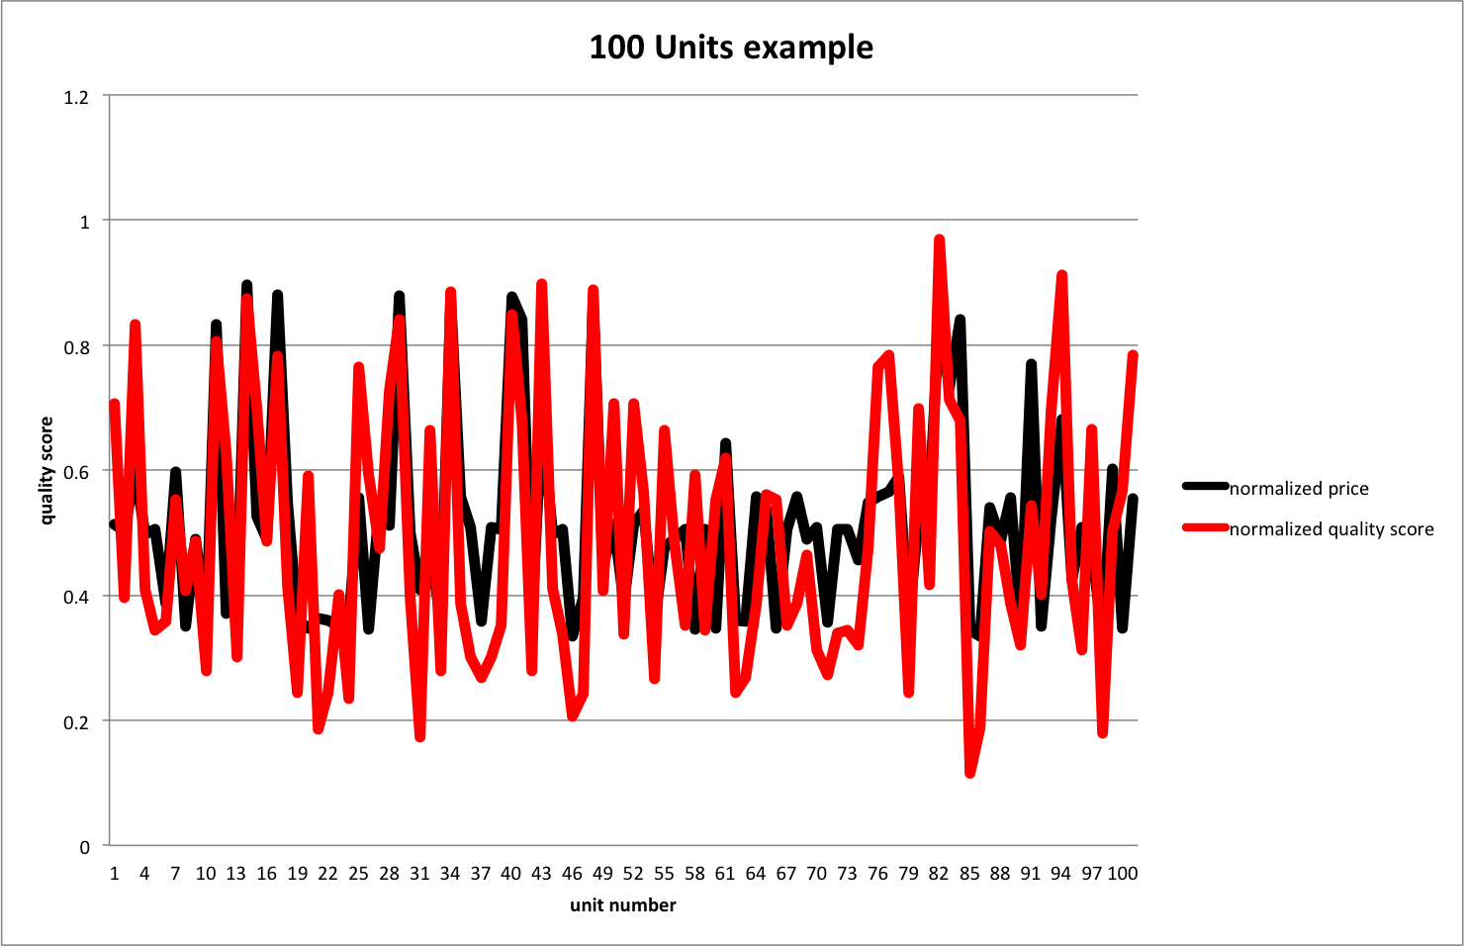
Result

Slide 18
Penalty tuning
Penalty weights incorporate our priors for the relative importance among different feature
-> rough estimates, manual tuning
-> not always reliable, time-consuming and non-flexible
Penalty weights can be tuned systematically to optimize the model
-> grid search (traditional)
-> random search (recently purposed)
-> combination of both
-> find optimized model among the ensembles
-> need an appropriate validation metric
-> lots of training !!

Slide 19
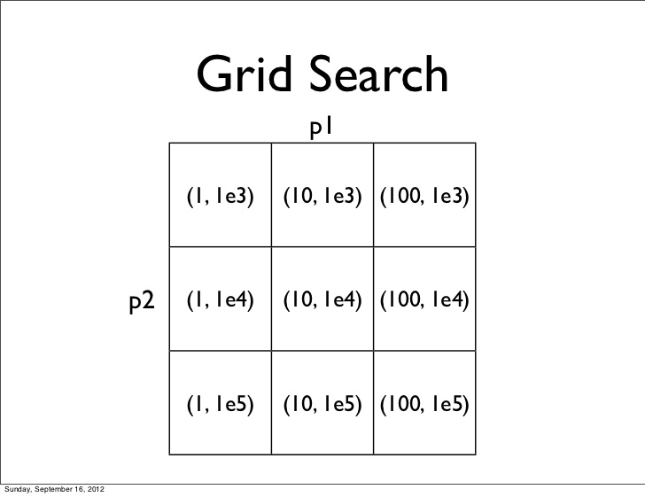
Grid search
1. Specify range and discretize
crime_penalty -> [a1, a2, …]
transit_penalty -> [ b1, b2, …]
shop_penalty -> [c1, c2, …]
….
2. Exhaustive search through parameter space
Cartesian product -> (a1, b1, c1, …),
(a1, b2, c1, …),
(a2, b2, c2, …),
…

Slide 20
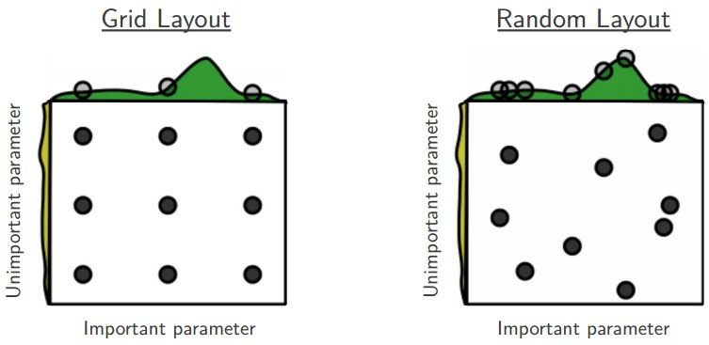
Random search
Form hyper-parameter sets by random sampling across different dimensions
Able to explore and evaluate more of the hyper-parameter space efficiently

Slide 21
Usage
Why Score Function ?
Represent individual condo unit quality
Efficient for comparing or ranking candidate units
Provide reference for product pricing

Slide 22
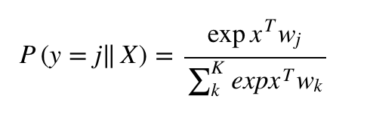
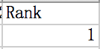
Pairwise comparison model
A simple logistic regression+ deep neural network model that takes raw feature values as inputs and provides binary outputs.
Applied a softmax to render the resulting predictions in the form of probabilities. The output of the Softmax function can be used to represent a categorical distribution, which stands for a probability distribution over 0 and 1.
Label = 1 means that unit1 is priced higher than unit2.
Unit1 has a higher quality.

Slide 23
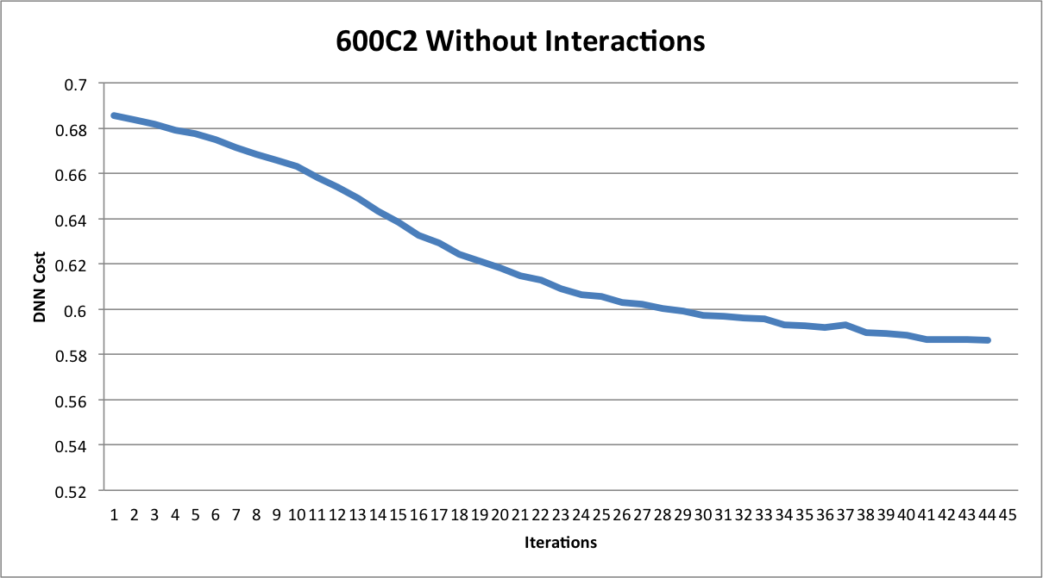
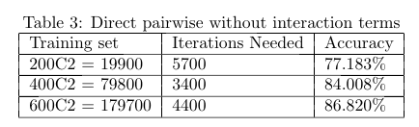
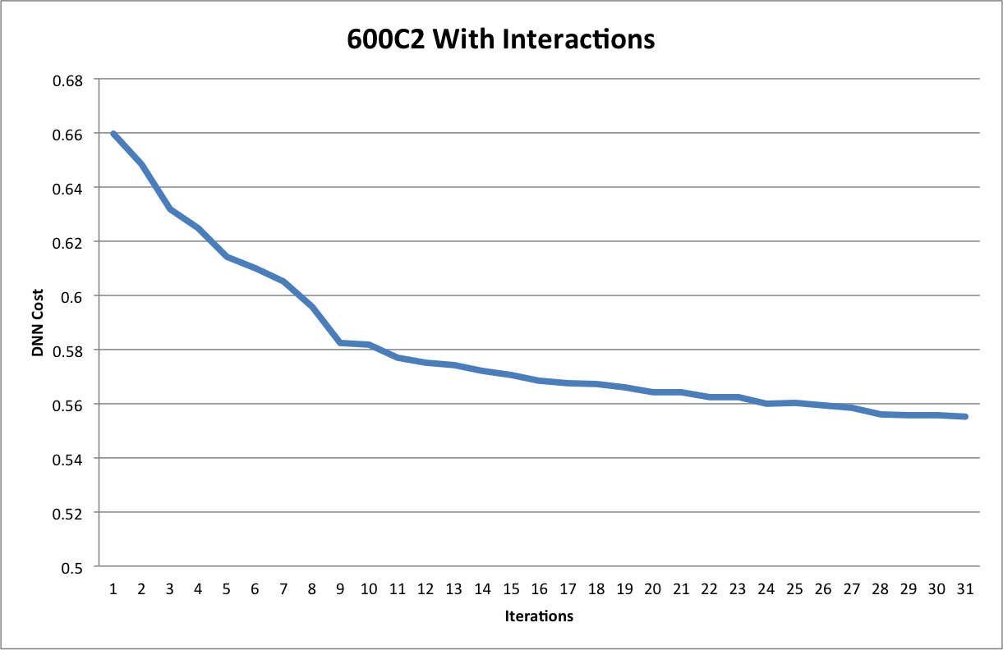
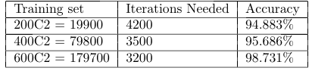
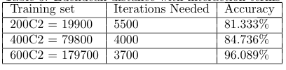
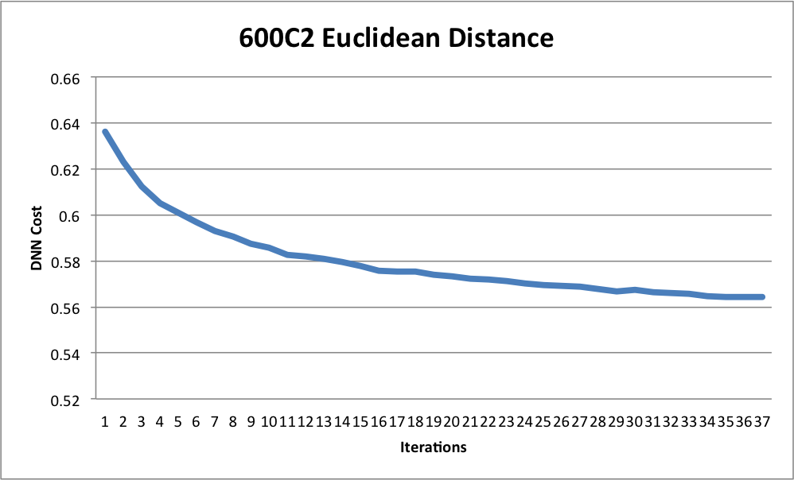
Experiment result
Case1: Direct pairwise comparison without interactions
Case2: Direct pairwise comparison with interactions
Case3: Euclidean distance with interactions

Slide 24
Evaluation
Refine Design
Score
Function
Unit Quality Ranking
Performance
Measures
(Accuracy,
HR@k, etc)
Comparison
Models

Slide 25
Future Work
Complement Comparison Models to enable listwise comparisons
Expand feature set, include historical data (time-series model)
Adapt online training, explore variants of autoencoder

